Slide 1

Aditi Jain (001038953)
Priyanka Ahuja (001573684)
Sushmita Maity (001092534)
Anjali Sajeevan (001563277)

Slide 2

Contents
Overview
Contribution
Screenshots

Slide 3
Overview
A react based Real Estate - Home search web application, that allows users to perform CRUD operations on the listing, view listing along with the location in google maps, detailed view, search and book tour. The users will also be able to view the Hot homes in the market and contact us. The admin keeps track of the uses and monitors the messages and contact us.

Slide 4
Contributions
Anjali Sajeevan (Buyer) - View Listings with favorites feature - Google Maps with advance search - Contact (UI and Backend) with email - Book tour (UI and Backend)
Aditi Jain (Seller) - CRUD (UI and Backend) - Chat Component (UI and Backend) - File upload to server - Image slider and Autocomplete
Priyanka Ahuja (Home Screen) - Wireframing & Logo - Home Screen, Login & Signup (UI) - Hot Homes (UI) - Hot Homes Chart (UI& Backend)
Sushmita Maity (Admin) - Admin Page (UI and Backend) and state management with Redux - Login and Signup (Backend and Redux) - Footer and lazy loading - Validations and toast messages

Slide 5
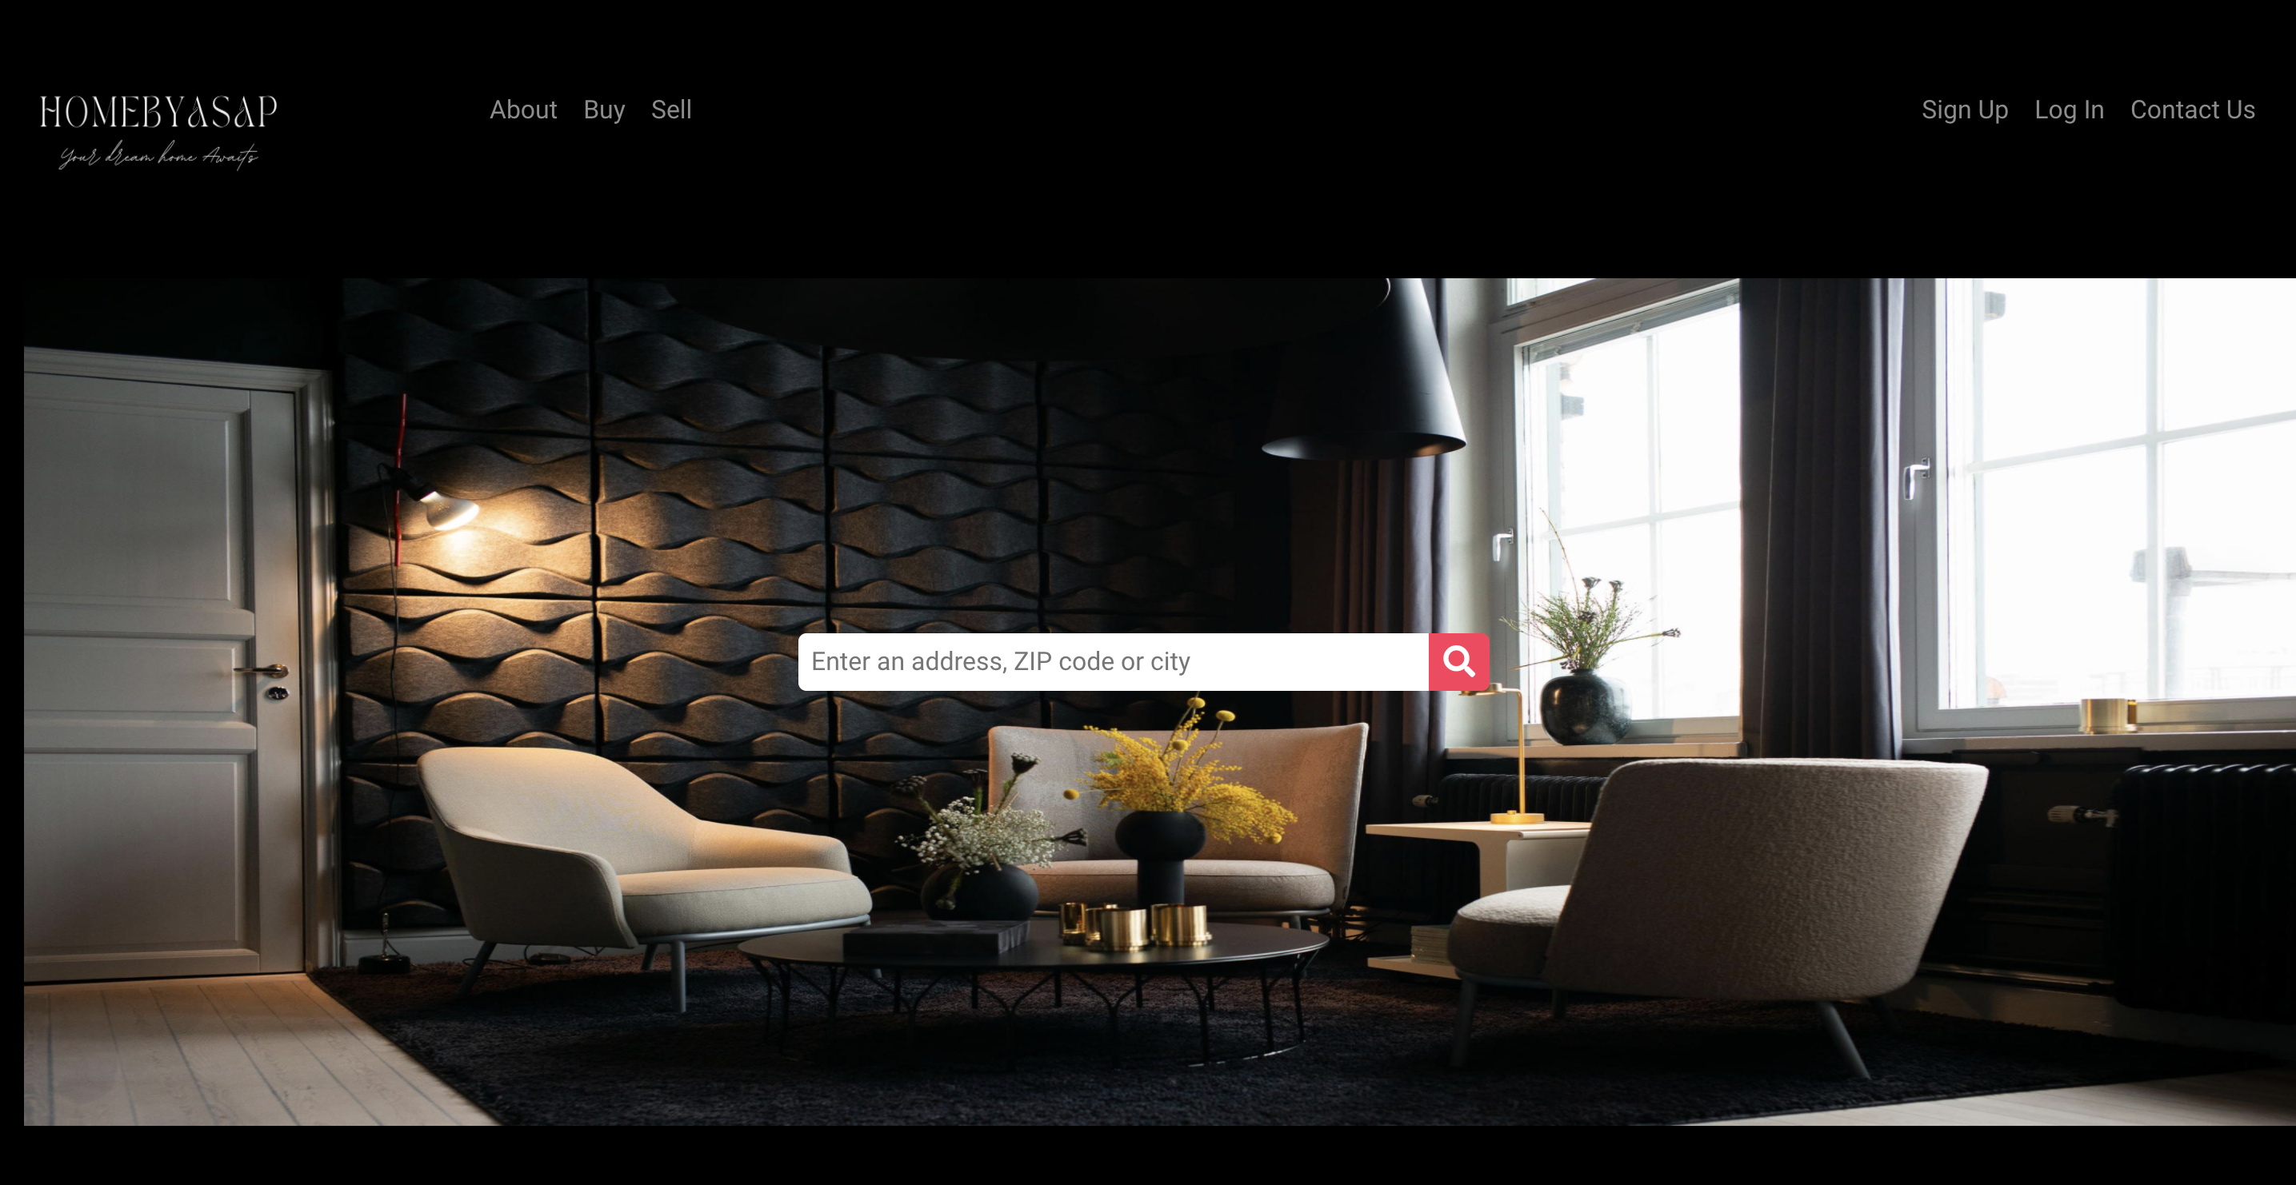
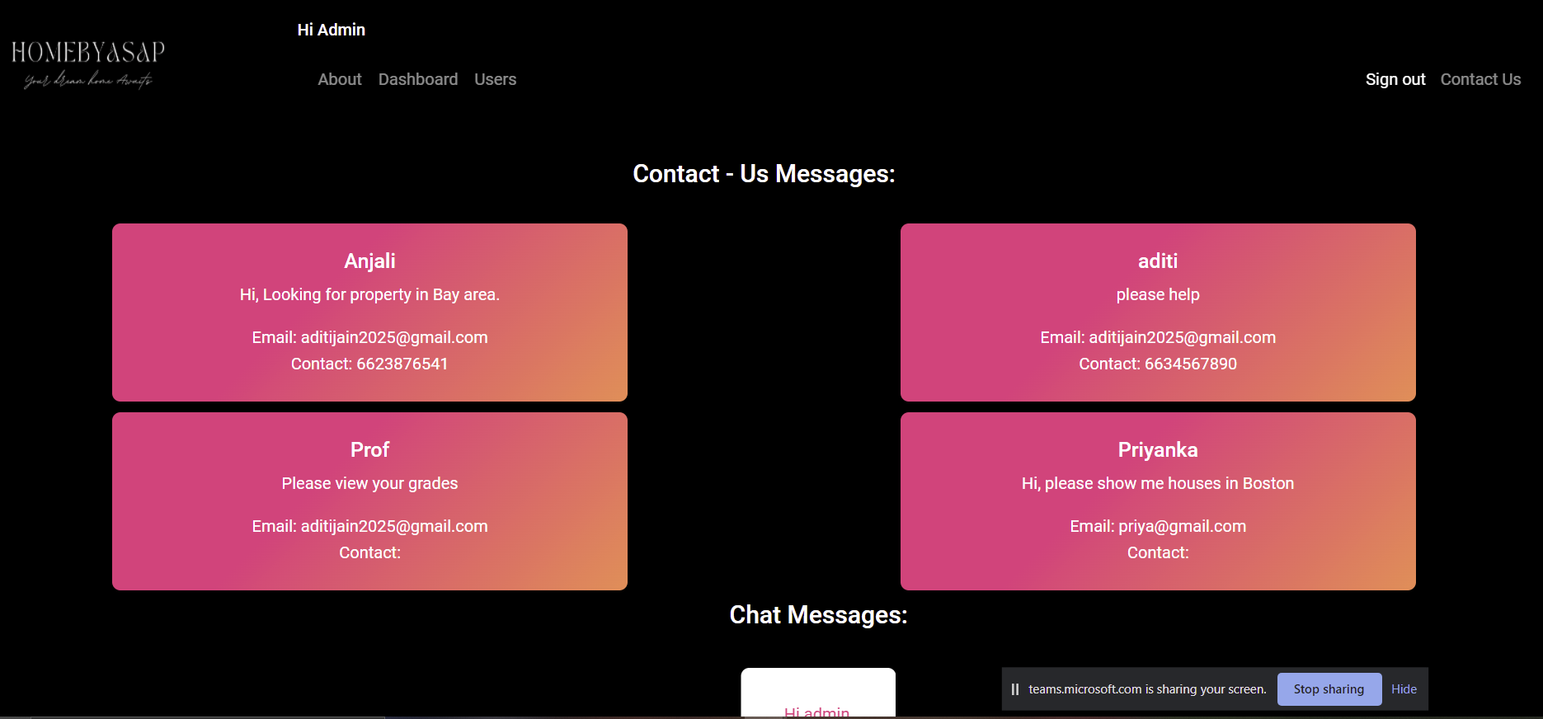
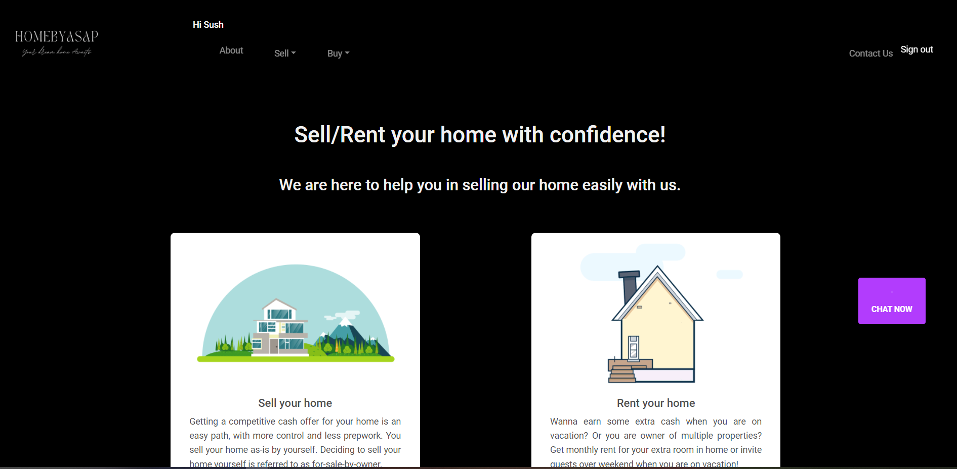
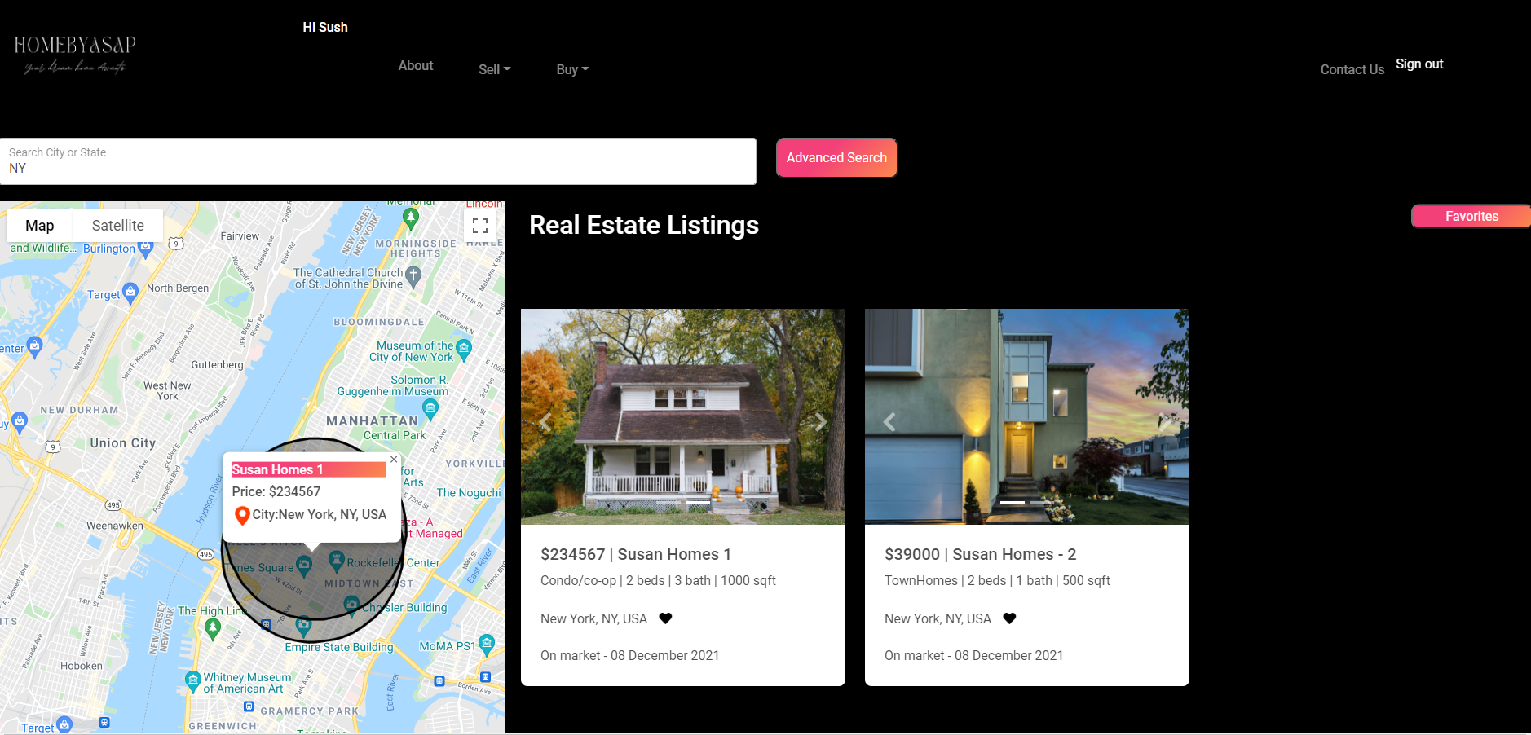
Screenshots

